Slide 2
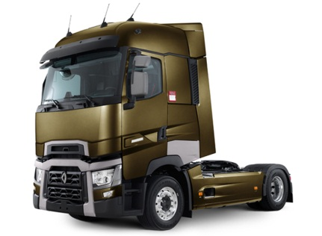
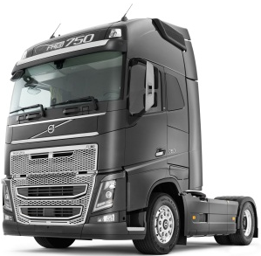

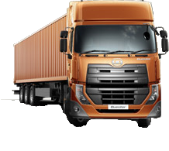
The new way! RT/PVT/FT (AET)
Update
Logged data
CAN trafic, Audio / video, GPS, snapshot
SW Release Function Package FP
I have logged an error !
The driver perspective!
QUEST/ (EEE)
PROTUS

Slide 3
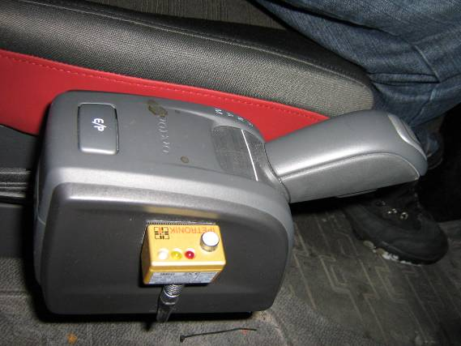
How to start the logger manually?
The microphone LED shows a blue light → system is ready
An error occurrs → the driver presses the button→ logging starts → LED shows a yellow light
Traffic is logged on up to 12 CANbuses (25 s BEFORE and 15s to 2 min AFTER the button is pressed)
Audio Commentary is recorded 15s-2 min AFTER the button is pressed
Video/picture (e.g. cluster/road information), 10s before button is pressed and 15s to 2 min after.
Trigger start button
Yellow light– logging in progress
Microphone
/!\ Wait 1 minute between 2 successive logs
Pressing the button while yellow LED extends recordings

Slide 4
DO019999.dat
Signal based measurements (eFACTS -> ”Snapshot data”).
All events in the same file.
One ”DOxx-file” for each ”Storage Group”
ASYNCHRONOUS
SIGNALS
CAN
SYNCHRONOUS
DO019999_x.csv
Converted event from storage group 1 with ”split trigger” attribute
TRAFFIC
T010019999.bin
CAN Traffic measurement.
Max 6 Traffic Groups
All CAN buses in same file
One file for each event
A010019999.wav
Audio measurement.
One file for each event.
No storage groups
V010019999.avi
Video measurement.
One file for each event.
1 USB Camera -> avi file format
1-4 cameras in video extender -> h264 file format
Video extnder files donloaded seperately
No storage groups
BDU_files
Response files from UDS jobs
A010019999.dat / V010019999.dat
Synchronization files for Audio resp. Video

Slide 5
Collector
Data Refiner
eFACTS Application Server
WCF Services for database interface (Oracle, NHibernate)
Organizer
Converter
External Services
Remote Collector
TruckSpec_Update
Database_Backup
Process Watchdog
FTP Server for ”Assist Me”
FTP Server for data download.
WEB Search Tool
External Data Import

Slide 6

EDB
TruckSpec_Update
Database Backup
External Services
RAW
External Data Import
Download external data
Convert to several formats
External
COLLECTOR (REMOTE)
Data integrity checks
Storage Group Validation
Split Measurement types
Parse UDS files (BDU)
ORGANIZER
Back-Up
Repacking RAW data
Creating Event Data Packages
Manage Auto-traffic measurements
Checking in data
Delete completed measurements
Send weekly statistics
Auto_Traffic
Data
WEB Search Tool
Search data by keys
CONVERTER
Convert data files to different formats
Create data package for ”Assist Me” FTP server
Transfer

Slide 7
RAW
Server Applications
PC Collector
AutoTraffic
Data export to
Safety, Poolman, ...
DATA
Server Collector
External
RDM
External Data Import Tool
RAW
Server Applications
PC Collector
AutoTraffic ?
DATA
Server Collector
RDM
GTDM
Data export to
Safety, Poolman, ...

